Slide 1
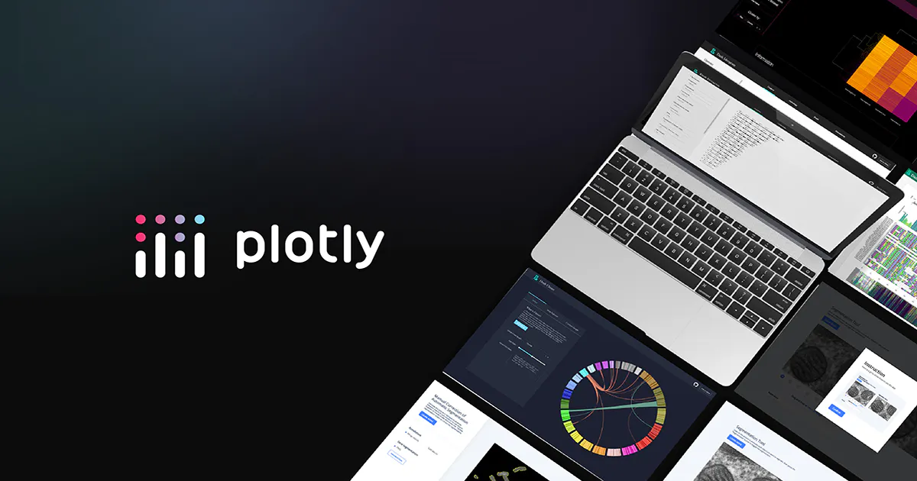
What is Plotly?
Plotly is an open-source data visualization library that allows users to create interactive and visually appealing charts, graphs, and dashboards. It supports a wide range of chart types and provides a user-friendly interface for creating interactive plots.

Slide 2
Benefits of using Plotly

Slide 3
Exporting and Sharing
Plotly allows its users to download charts from visualizations in different formats e.g., PNG’s, HTML, PDF and SVG. A user can also share Plotly visuals online or embed them in web applications.
Customization Options
Plotly has high-level customization abilities that allow for preferential design e.g., modify colours, markers, labels, annotations, layouts and more.
Dashboards and Applications
Plotly allows its users to have interactive charts e.g., cross-filtering. Through the Dash framework, Plotly can be used in web applications.
Extensive Chart Types
Plotly has a wide range of charts e.g., line charts, histograms, choropleths, bar charts, maps etc.
Interactive Visualizations
Users create interactive plots with zooming, panning, hovering, and other interactive features.
Easy Integration
It’s easy to use Plotly with other Python libraries e.g., NumPy, Pandas and SciPy.
01.
02.
03.
04.
05.
06.

Slide 4
Plotly Modules
Plotly offers several modules that cater to different functionalities and user preferences when creating visualizations.

Slide 5
Plotly Graph Objects (go)
Provides core building blocks for creating visuals including essential features like figure.
https://plotly.com/python/graph-objects/
Plotly Express (px)
High-level API that allows its developers to create common plot types easily through dataframes.
https://plotly.com/python/plotly-express/
Plotly Subplots
Allows its users to create layouts with multiple subplots (multiple plots within a single figure).
https://plotly.com/python/subplots/
Plotly Offline
Enables offline use of Plotly, allowing one to render and display plots within Jupyter notebooks or standalone HTML without requiring a webserver or internet connection
Plotly Figure Factory
Offers pre-built templates for quicker creation of specialized visualizations.
https://plotly.com/python/figure-factories/
Plotly io
Provides functions for exporting your plots to various image formats (e.g., PNG, JPEG) and interacting with plotly figures programmatically.
https://plotly.com/python-api-reference/generated/plotly.io.html
01.
02.
03.
04.
05.
06.
Notes:
Plotly Graph Objects
- Figure – the foundation of your plot, holding data and layout elements.
- Using go objects, you can construct complex visualizations by defining the data, layout properties, and interactions specific to your needs.
Plotly Express
- Plotly Express provides functions for various plot types like scatter, line, bar, histogram, pie, etc., automatically handling data formatting and visualization tasks.
Plotly Subplots
- It offers functionalities for arranging multiple plots in a grid-like fashion, sharing axes across subplots.
- Use plotly.subplots when you need to display several related plots simultaneously within the same figure.
Plotly Figure Factory
- One can create templates for specific plot types e.g., choropleths, heatmaps, etc.

Slide 6
When to use Graph Objects
Plotly offers several modules that cater to different functionalities and user preferences when creating visualizations.

Slide 7
When a figure has not yet been created for plotly express e.g., 3D trace-types like mesh or isosurface.
When creating a plotly express chart and the figures are cumbersome e.g., subplots of different types, dual-axis plot or faceted plots with multiple different types of traces.
In this case, it’s easier to create such figures from an empty plotly.graph_objects.Figure object, and progressively add traces and update attributes above.
Figures produced by plotly Express in a single function-call are easy to customise at creation-time and to manipulate after creation using the update_* and add_* methods.
01.
02.
NOTE

Slide 8
RESOURCES
Language – Python
Package manager – pip / conda
Interactive Development Environment (IDE) – VS Code.
VS code extensions.
Documentation - https://plotly.com

